Slide 1


Slide 2

KANDESN® WORKSHOP AGENDA
Personal Testimonials
Assign 1–2 assistants, potential IBOs, etc., to share their personal testimonials about Kandesn® products
Why Choose Kandesn® And Sunrider® Products?
Why we need good skin care
Owner Expertise
Philosophy of Regeneration®
Superior ingredients and formulation
State-of-the-art manufacturing

Slide 3
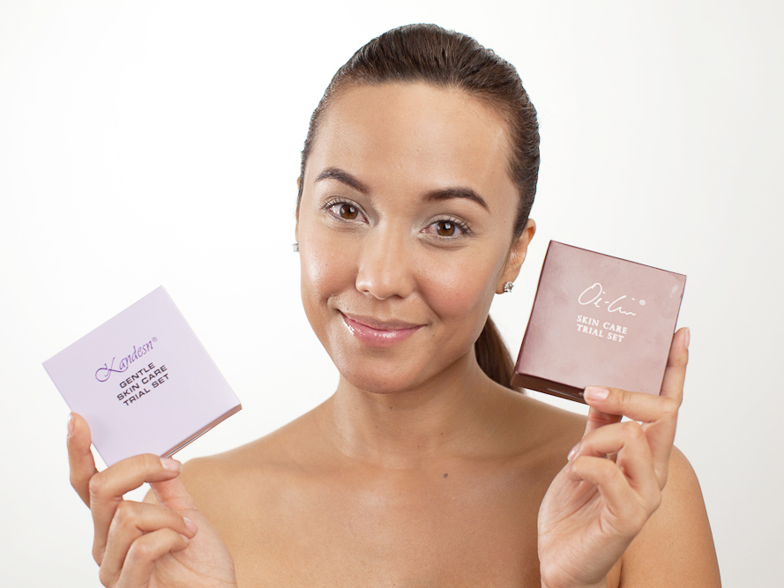
WHICH SKIN CARE SET IS RIGHT FOR YOU?
Kandesn® Gentle Skin Care Set
or
Oi-Lin® Skin Care Gift Set

Slide 4
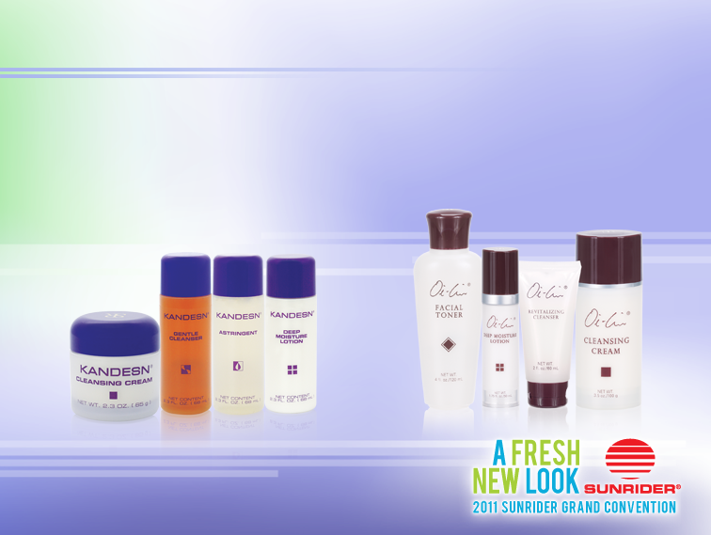
WHICH SKIN CARE SET IS RIGHT FOR YOU?
The Kandesn® Gentle Skin Care Set contains carefully selected products designed to soothe skin sensitivities. Each product performs effectively yet gently, allowing the user to enjoy the benefits without irritation or discomfort.
The Oi-Lin® Skin Care Gift Set contains the essential products of our premium skincare line. This will cleanse, balance, and hydrate your skin for a smooth, youthful-looking complexion.

Slide 5
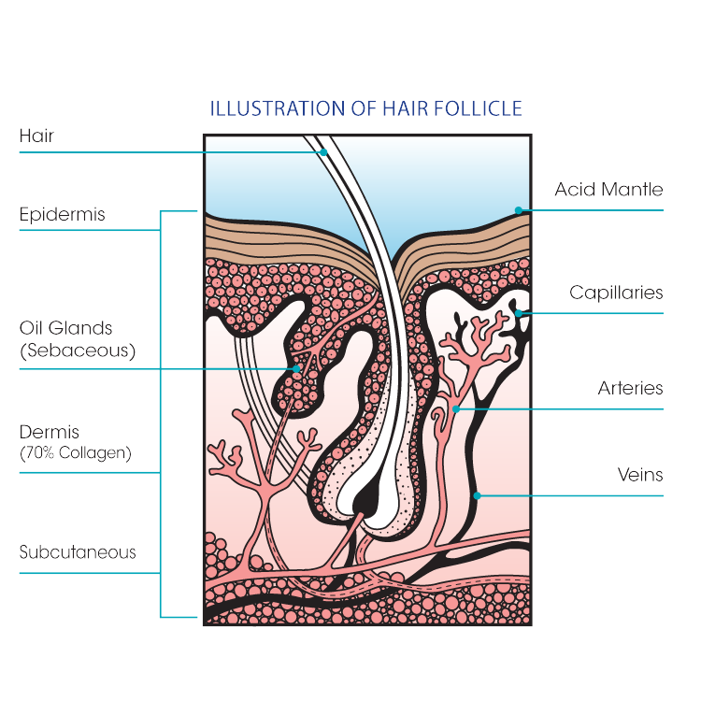
WHY WE NEED SKIN CARE
The Acid Mantle
Skin has a slightly acidic pH of 5.5. This acid mantle protects skin from bacteria and pollution, and helps to seal in moisture.
Natural Cleansing
The millions of pores and hair follicles covering our body play a vital role in the natural cleansing function. Clogged pores result in blemished and unhealthy skin.

Slide 6
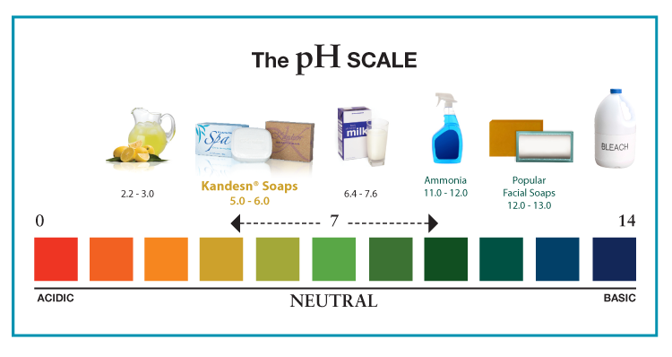
WHY CHOOSE KANDESN®
pH Balanced
Kandesn® products are pH balanced to protect the acid-mantle barrier.
High-Quality Ingredients
We use high-performing, naturally derived ingredients.

Slide 7
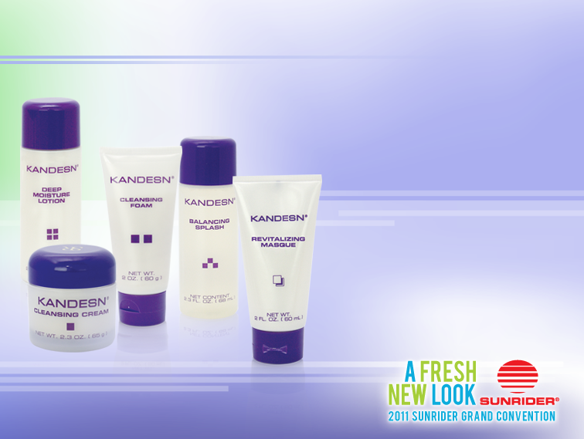
KANDESN® GENERAL SKIN CARE
Kandesn® Skin Care products are suitable for younger and normal skin types.
Formulated with herbal extracts and superior ingredients.
Everyone should experience the Kandesn® Revitalizing Mask. It makes all the other products more effective.

Slide 8
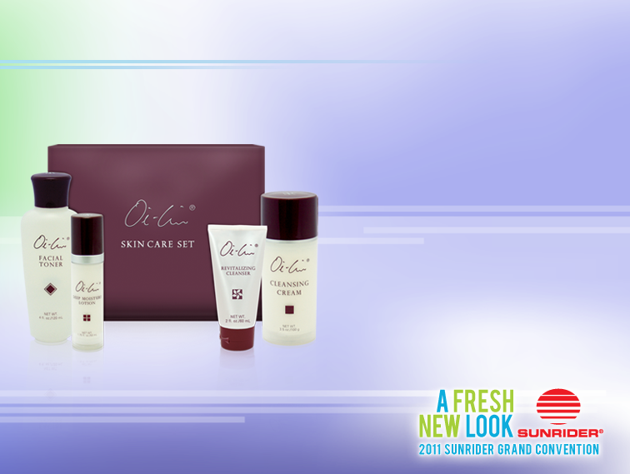
OI-LIN® SKIN CARE REGIMEN
Cleansing Cream
Oil-based cleanser removes make-up, pollution, and oil-based impurities.
Gentle Cleanser/
Revitalizing Cleanser
Water-based cleanser deep cleans to remove water-based impurities.
Astringent/Facial Toner
Alcohol-free solution tones and balances skin, preparing it for moisturization.
Deep Moisture Lotion
Water-based moisturizer penetrates pores for deep hydration.

Slide 9
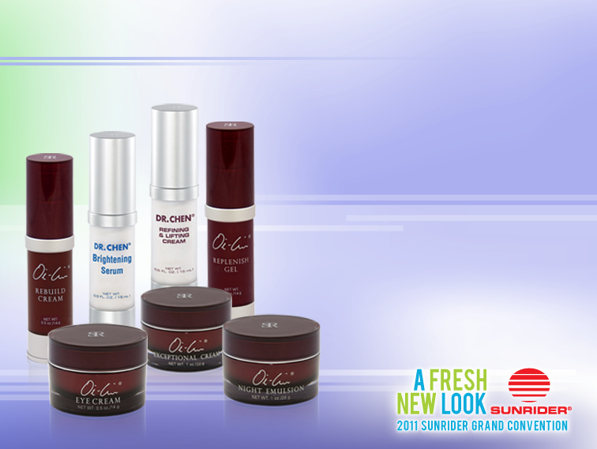
SPECIAL SKIN CARE TREATMENTS
Signature Special Treatments
Fast-acting formulas with the latest anti-aging ingredients.
Address virtually every skin-care need.
There is a special treatment to address all of your specific needs.
Promotional Tip

Slide 10
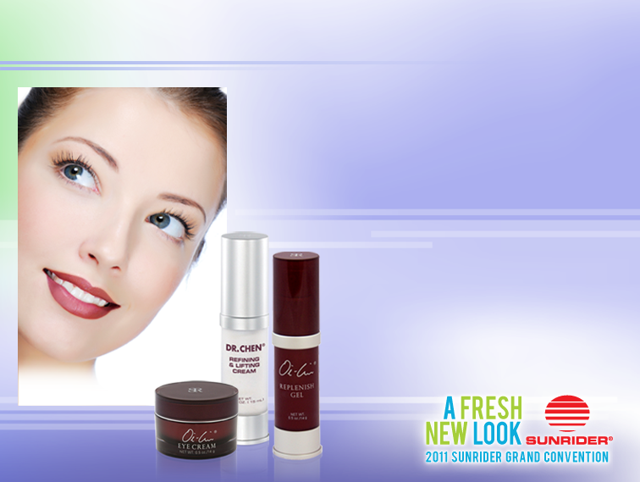
KANDESN® SPECIAL TREATMENTS FOR EYES
These cutting-edge treatments work especially well together. Apply them in this order to your eye or anywhere you want results!
Oi-Lin® Eye Cream
Moisturizes, reduces puffiness, and diminishes the appearance of dark circles.
Dr. Chen® Refining &
Lifting Cream
Fast-acting, long-lasting formula to hydrate and improve skin texture.
Oi-Lin® Replenish Gel
Anhydrous gel seals in moisture for intense hydration.

Slide 11
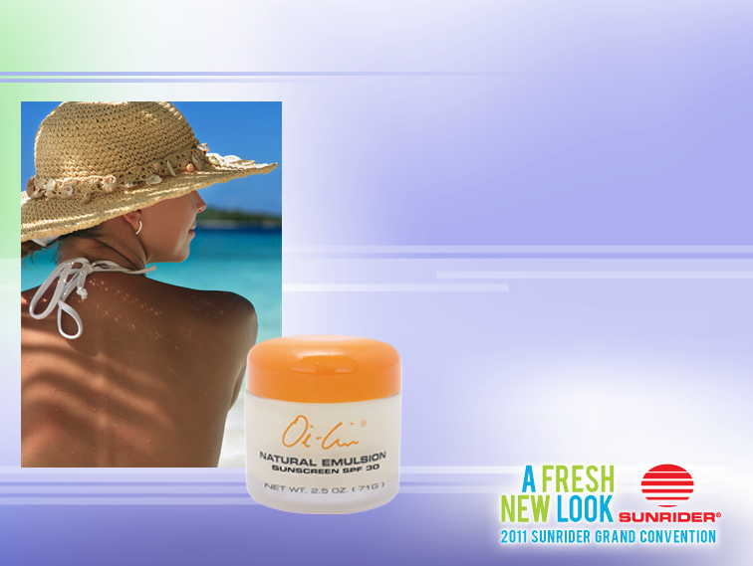
OI-LIN® SUNSCREENS
Protect your skin. Remember to use our Oi-Lin® Sunscreens every day!
Sunscreen is essential to preventing premature aging, wrinkles, skin damage, and skin cancer.
Our sunscreens have broad-spectrum UVA/UVB protection.
Concentrated and non-greasy with the same high quality ingredients as our other skin-care products.

Slide 12


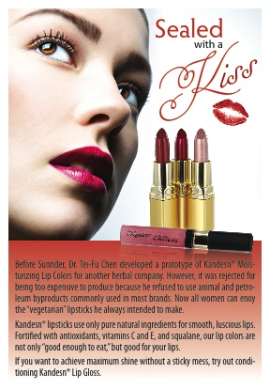
KANDESN® MARKETING TOOLS
Today’s Business Strategy
How to attract new customers.
How to get referrals.
9
Notes:
How to make your Sunrider store thrive.
Get to really know your customers – ask questions and listen intently.
If you give outstanding customer service you will gain your customers loyalty and trust
Strategies to help build a successful business
Every customer has a rewarding shopping experience when they come into your store
Give advice with honesty and integrity
Special events

Slide 13
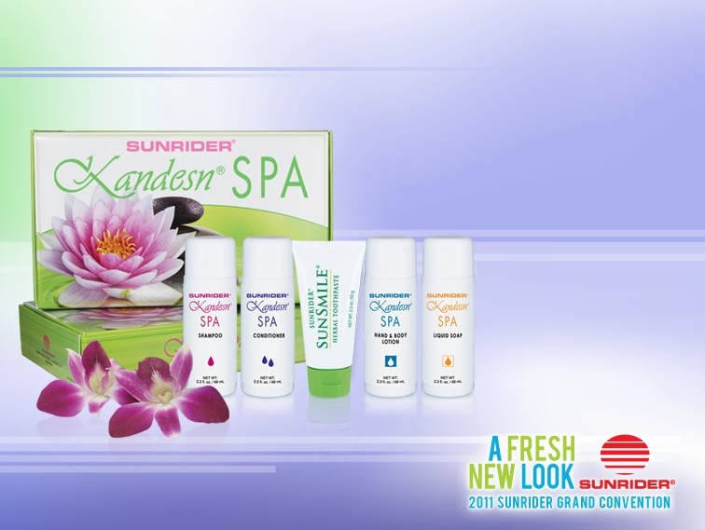
KANDESN® SPA SET
A great way to introduce people to our personal care products.
Sizes are perfect for travel.
Notes:
13
Be sincere and genuine form the beginning the customer is buying from you because she likes you!
Always meet all her needs
Give her options – People like to have control over their buying decisions

Slide 14

KANDESN® Business Tips
Today’s Business Strategy
How to attract new customers (customer service)
How to connect
(listen, customer service)
How to introduce customers to products
How to demonstrate
How to close a sale
How to increase sales
How to get referrals
9
Notes:
How to make your Sunrider store thrive.
Get to really know your customers – ask questions and listen intently.
If you give outstanding customer service you will gain your customers loyalty and trust
Strategies to help build a successful business
Every customer has a rewarding shopping experience when they come into your store
Give advice with honesty and integrity
Special events

Slide 15
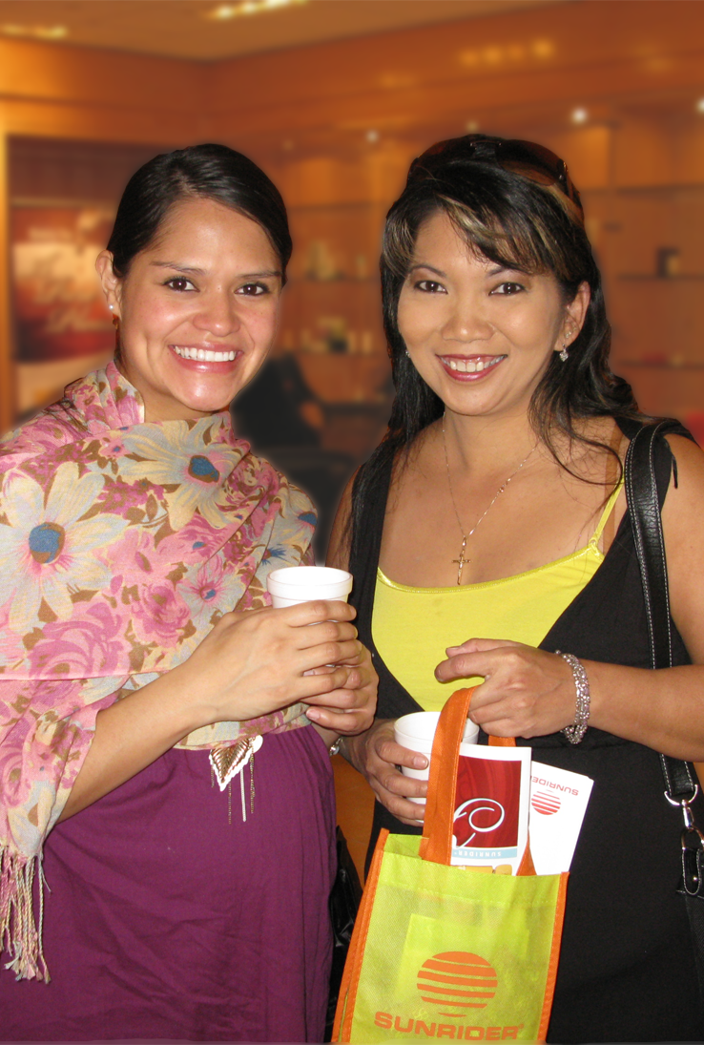
HOW TO CLOSE THE SALE
A sale begins in the first few minutes of meeting the customer.
Assumptive Close, you assume they are buying.
Choice Close
Bonus Close
11

Slide 16
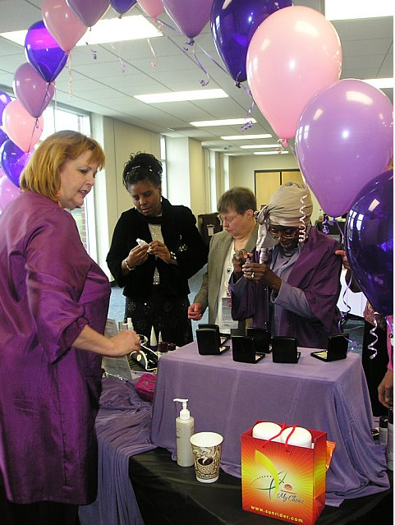
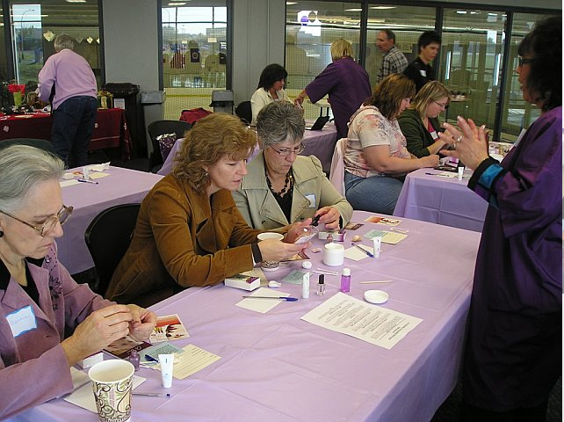
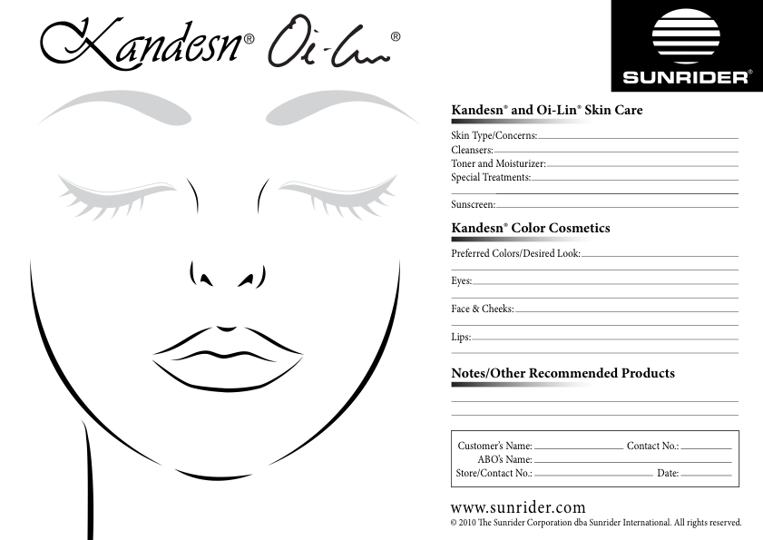
CLIENT REGISTRY
Available on the Sunrider Training Website.
Helps to keep track of customer purchases and interests.
Teach client to duplicate a desired look.
12

Slide 17


