Slide 1


Slide 2
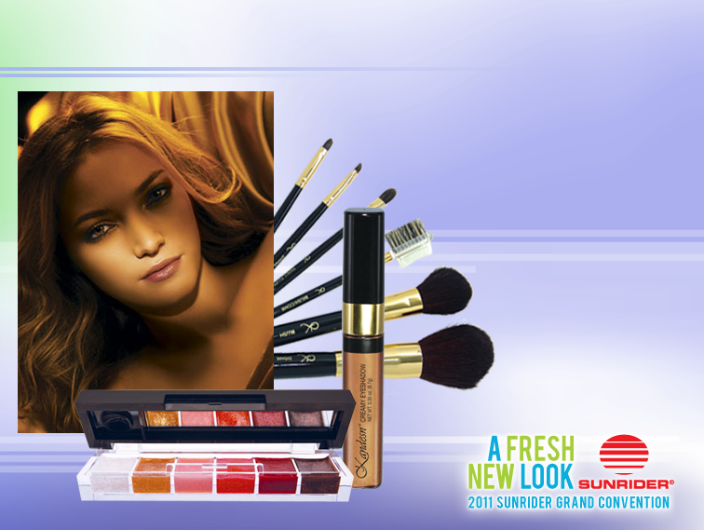
KANDESN® COLOR COSMETICS
Our multi-tasking cosmetics create fresh beauty for women of all ages and ethnicities.

Slide 3
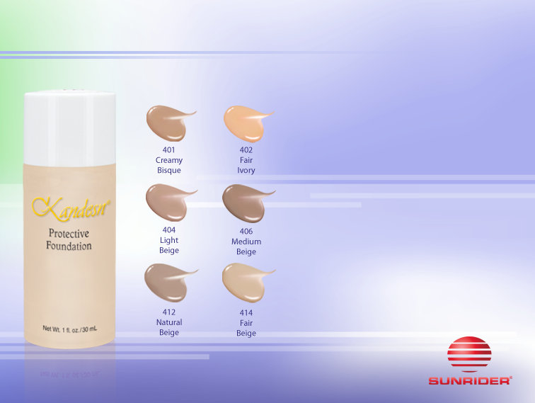
KANDESN® COLOR COSMETICS
Kandesn®
Protective Foundation
Why is Kandesn® Protective Foundation superior to others on the market?
Our foundation is made with quality ingredients, such as vegetable-origin squalane and jojoba oil.
Looks beautiful on all skin types.

Slide 4
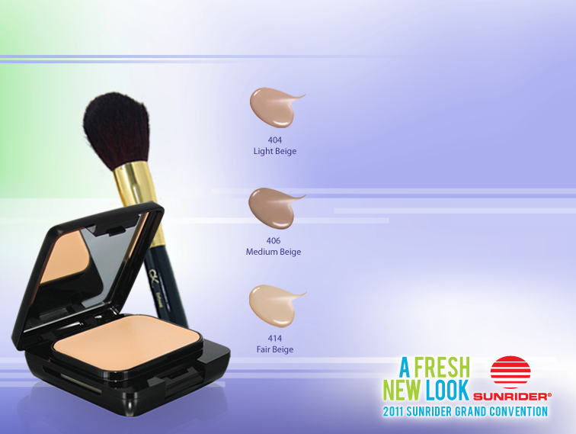
KANDESN® COLOR COSMETICS
Kandesn®
Dual-Pressed Powder
A liquid foundation and translucent powder all-in-one, it provides velvety, natural coverage that’s healthy for your skin.
18

Slide 5
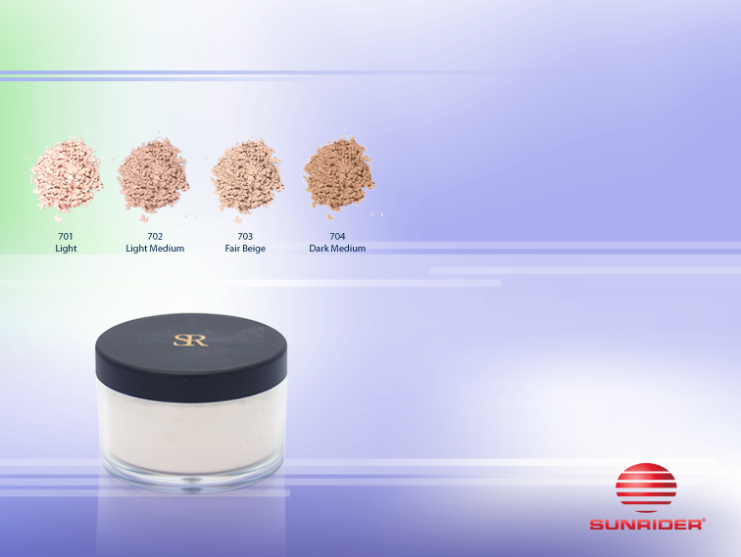
KANDESN® COLOR COSMETICS
Kandesn® Sheer Silk
Translucent Powder
Kandesn® powder will even out and brighten sallow skin. Sets makeup professionally.

Slide 6

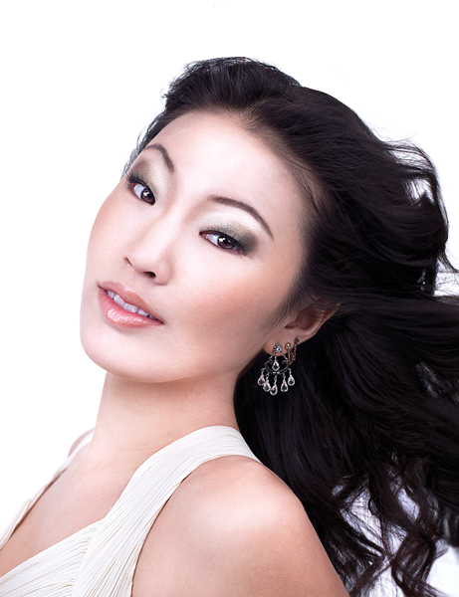
QUICK & EASY COLOR
EYE COLOR | EYE LINER | EYE SHADOW
 | brown taupe | rich, warm browns, warm taupes, soft peaches, soft green Kandesn® Mini Compacts 3, 4, 7
 | brown black | golden browns, warm taupes, deep purples, soft peaches, soft violets Kandesn® Mini Compacts 1, 3, 4, 7
 | brown taupe black | golden brown, blue, green, charcoal, purple Kandesn® Mini Compacts 1, 2, 6, 7, 8
 | brown black | Charcoal, cool brown, purple, green Kandesn® Mini Compacts 1, 2, 6, 7, 8

Slide 7
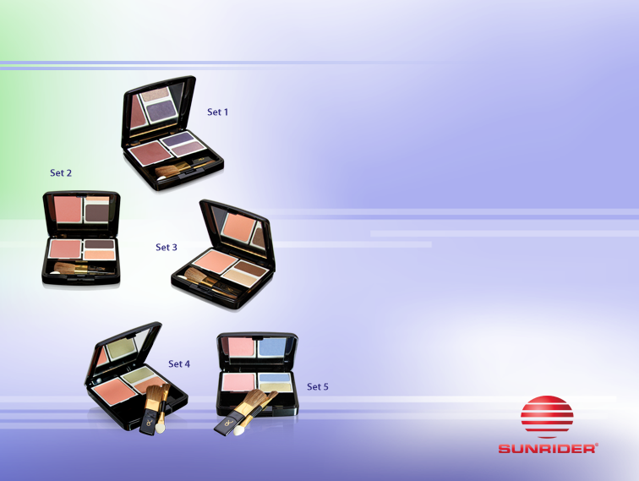
KANDESN® COLOR COSMETICS
Sophisticated Kandesn® Mini Compact
Fashionable colors help create quick & easy flattering looks for any occasion…day or night!

Slide 8
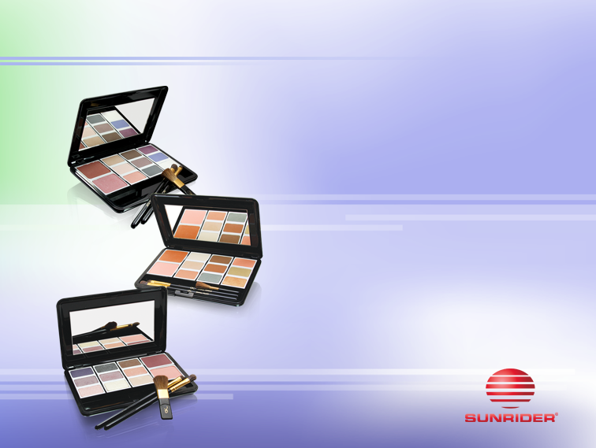
KANDESN® COLOR COSMETICS
Sophisticated Kandesn®
Advisor Compact
Fashionable colors help create quick & easy flattering looks for any occasion…day or night!

Slide 9
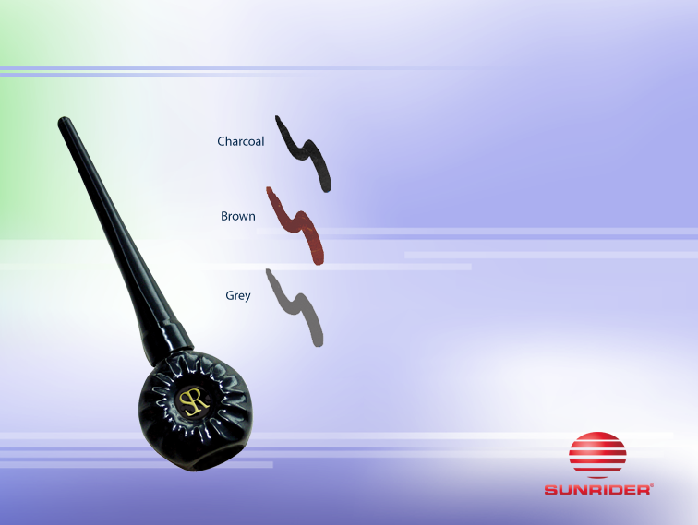
KANDESN® COLOR COSMETICS
Kandesn®
Liquid Eyeliner
Easy to use, in a variety of classic colors, for every stylish makeover.

Slide 10
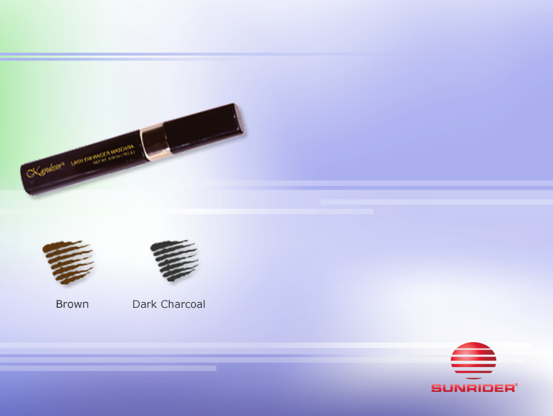
KANDESN® COLOR COSMETICS
Kandesn®
Lash Enhancer Mascara
• Moisture-enriched and long-lasting.
• Contains soy protein to help strengthen and achieve the appearance of longer lashes.
• Especially formulated not to irritate the eyes, a common problem with mascara usage.

Slide 11
KANDESN® COLOR COSMETICS
EYEBROW SHAPE & COLOR
Fill in the eyebrows where there are any gaps and also to elongate the brow on the outer side of the eye toward the hairline.
Fill in the eyebrows with the Kandesn® Blonde pencil 906 for lighter brows, Medium Brown 905 or Black 901 for darker brows.

Slide 12
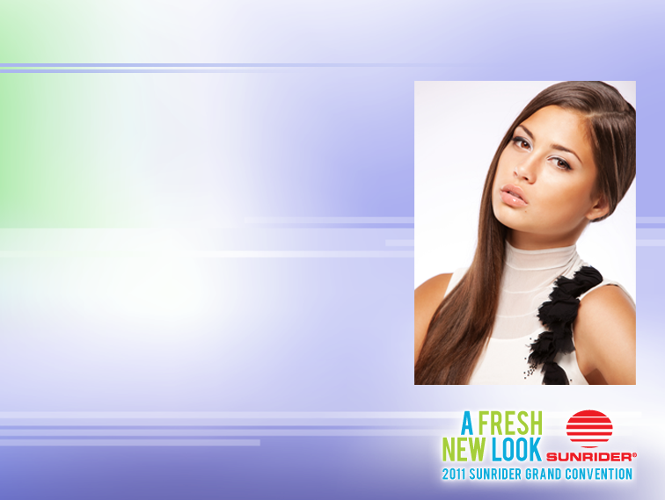

KANDESN® COLOR COSMETICS
BASIC EYE MAKEUP APPLICATION
Barely There
Apply Dark Brown Kandesn® Creamy Eyeshadow as you would an eye liner to lower and upper lash line and smudge.

Slide 13
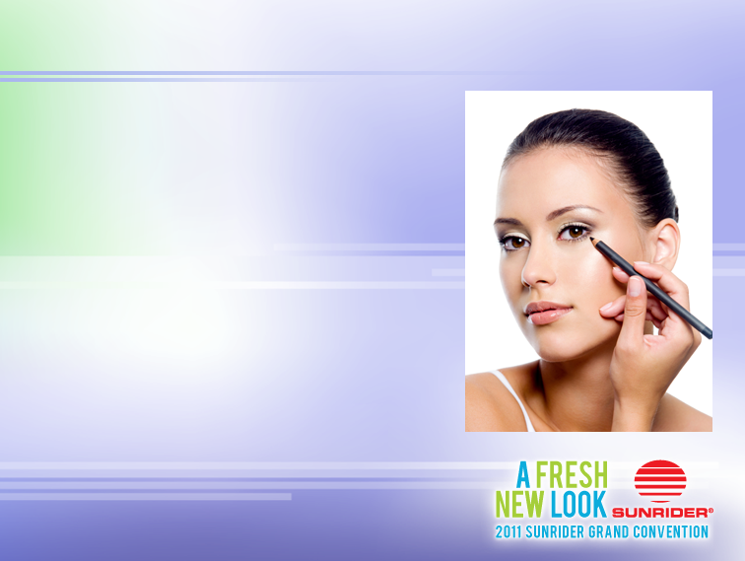

KANDESN® COLOR COSMETICS
BASIC EYE MAKEUP APPLICATION
Daytime Business
Apply base color to entire lid.
Blend contour color from outside corner
of lash line, blending inward.
Highlight just above the iris and under the brow.

Slide 14
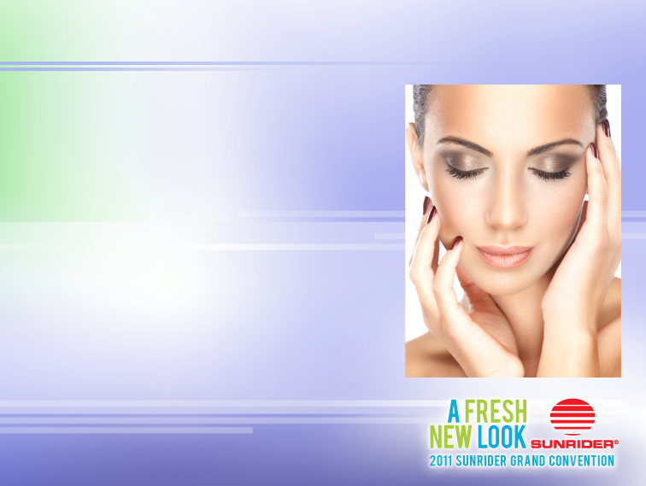

KANDESN® COLOR COSMETICS
BASIC EYE MAKEUP APPLICATION
Romantic Glamour
Apply base contour shadow to entire eye lid.
Blend contour shadow from outside corner inward.
Add accent color just inside the “V’
Finish with highlight to just above the iris and below the eye brow.

Slide 15
QUICK & EASY COLOR
EYE COLOR | EYE LINER | EYE SHADOW
 | brown taupe | rich, warm browns, warm taupes, soft peaches, soft green Kandesn® Mini Compacts 3, 4, 7
 | brown black | golden browns, warm taupes, deep purples, soft peaches, soft violets Kandesn® Mini Compacts 1, 3, 4, 7
 | brown taupe black | golden brown, blue, green, charcoal, purple Kandesn® Mini Compacts 1, 2, 6, 7, 8
 | brown black | Charcoal, cool brown, purple, green Kandesn® Mini Compacts 1, 2, 6, 7, 8

Slide 16
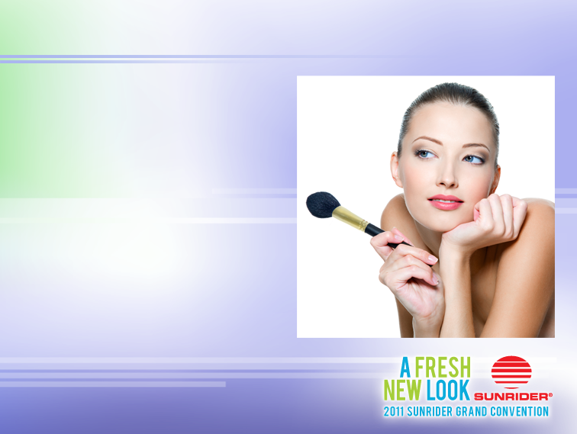
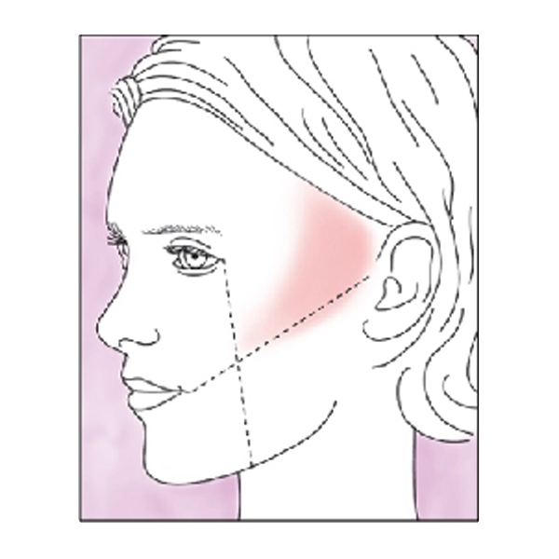
KANDESN® COLOR COSMETICS
BASIC BLUSH APPLICATION
Suck in cheeks, feel along cheekbone tracing downward until you feel hollow beneath the “C”.
Apply color here and lightly blend backwards toward ear.
Blush is a highlight—use blush to emphasize your best features.

Slide 17
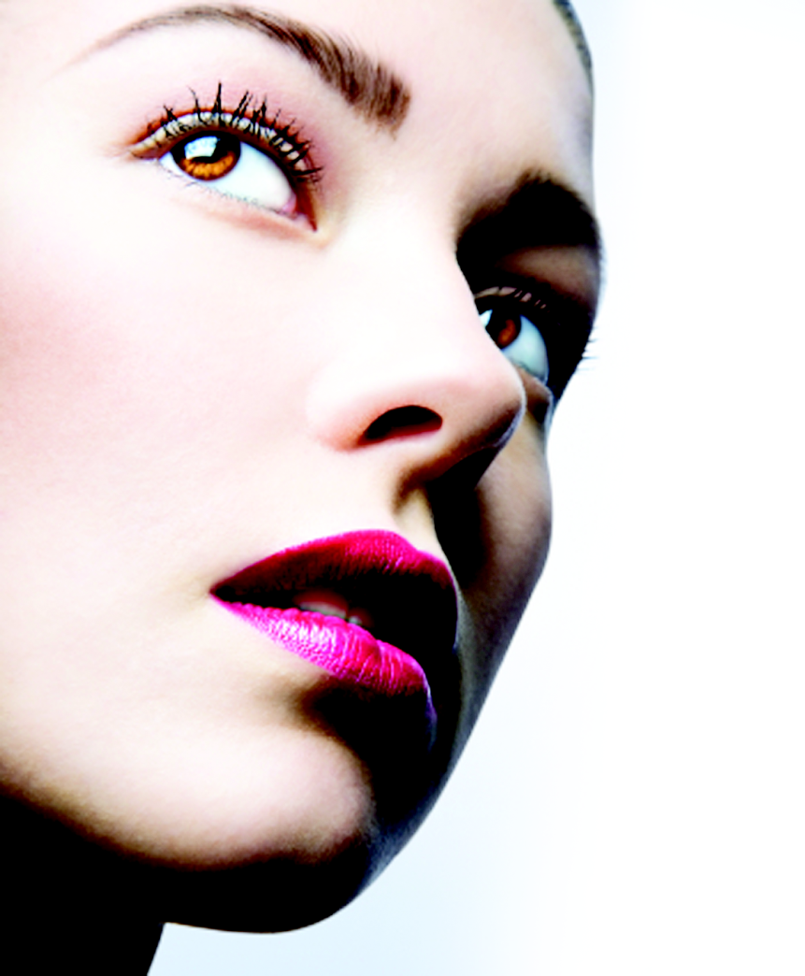
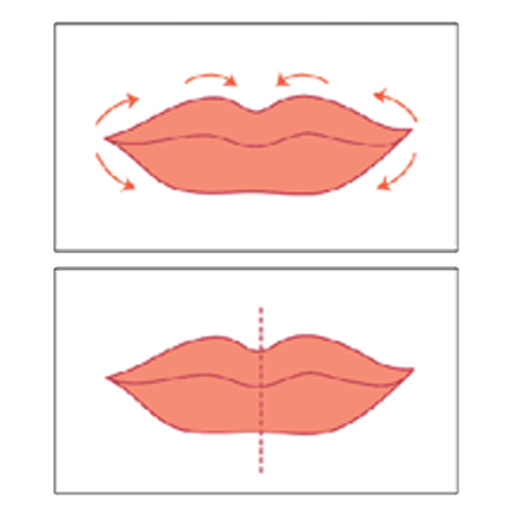
KANDESN® COLOR COSMETICS
BASIC APPLICATION TIPS FOR LIPS
Lip Pencil
Use Lip Liner Pencil to outline lips.
Lip Color
With lip brush, apply Kandesn® Moisturizing Lip Color. Begin at outer corners of the mouth, moving in.
Lip Gloss
Apply Lip Gloss to center of lips.

Slide 18
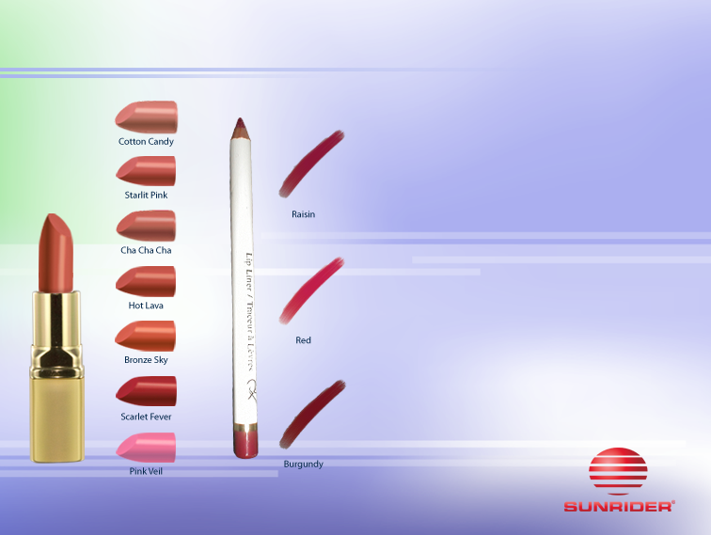
KANDESN® COLOR COSMETICS
Kandesn® Moisturizing
Lip Colors
We make out Lip Colors with the choicest ingredients including Vitamin E and squalane.
Kandesn®
Lip Liner Pencil
Beautifully define and contour your lips with our lip liner pencils.

Slide 19
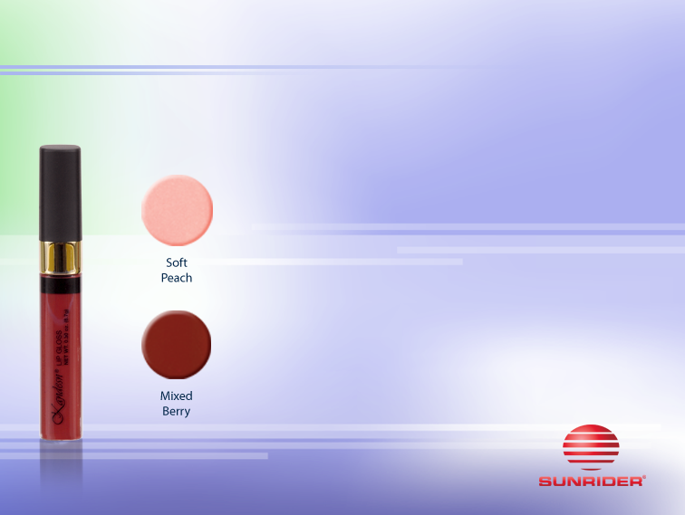
KANDESN® COLOR COSMETICS
Kandesn® Lip Gloss
Fashionable and easy to use.
Vitamin E enriched to protect lips.
Create any look you desire
Natural barely-there look
Daytime Business–add lip liner.
Nighttime glamour–apply over your favorite Kandesn® Lip Color.

Slide 20
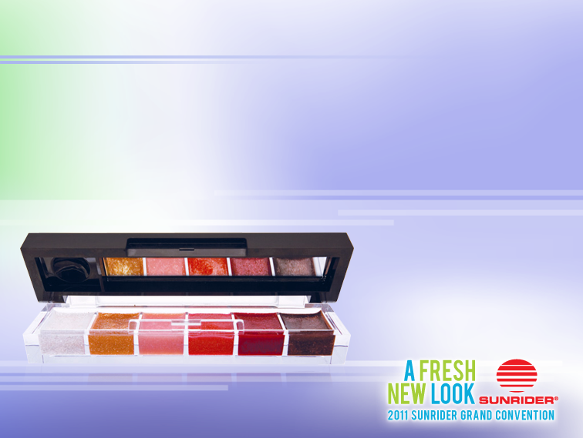
KANDESN® COLOR COSMETICS
Kandesn® Lip Gloss Palette
Versatile kit contains six mini-lip glosses in one deluxe palette.
Palette offers a wide range of colors which can be blended.
Complete with tiny mirror for on-the-go touch ups.
Pop in your pocket and be dazzling all day long.

Slide 21

KANDESN® COLOR COSMETICS
Kandesn®
Forbidden Parfum
Forbidden™ Parfum has a cool top note (initial scent) of jasmine with hints of mint and melon, a heart note (transitional scent) of jasmine and rose, and a base note (lasting, lingering scent) of green tea, pine and oriental spices.

Slide 22


